Slide 1

Architecture for reddit data analysis
Project for the large scale data management course
Francesco Porto 816042 Mattia Vincenzi 860579

Slide 2
overview
Objectives of this project
Architecture
Components
Scryper
Kafka
Speed Layer
Batch Layer
Deployment
Conclusion

Slide 3

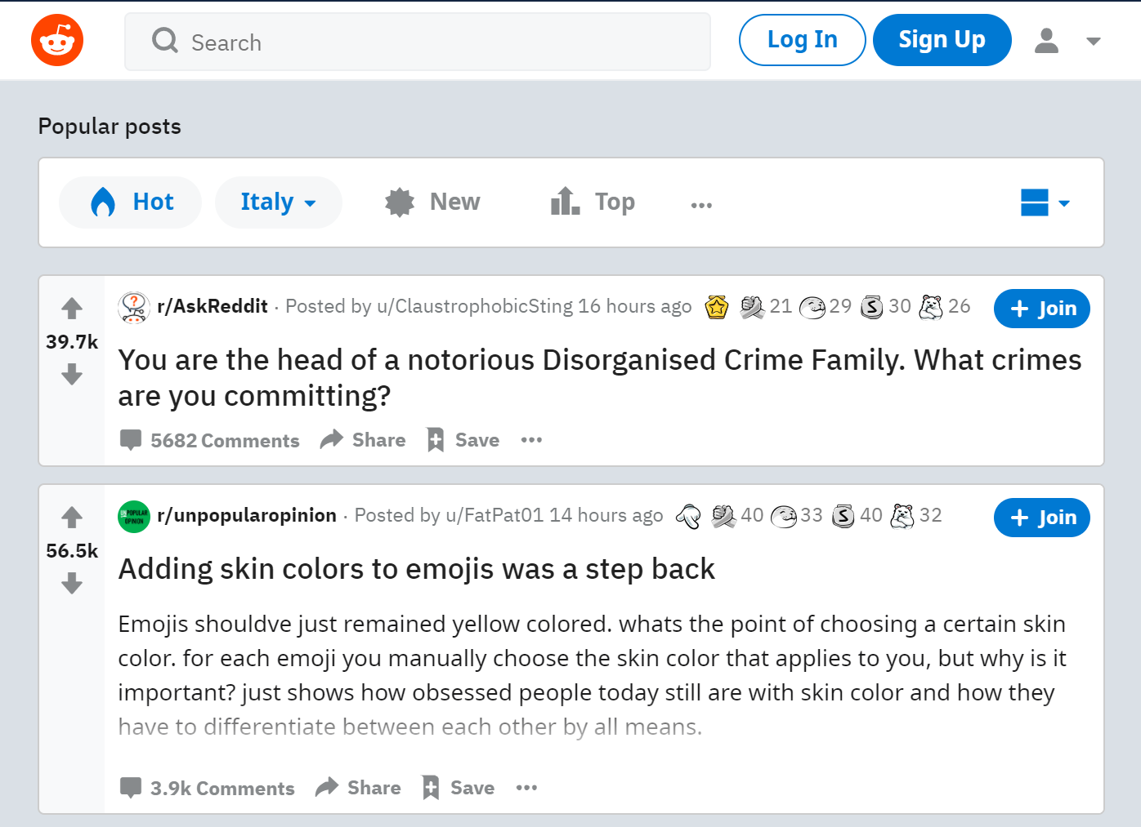
Objectives
Reddit is an online forum with over 50 milion daily users
Plenty of data is available
Offers APIs for easy data access
Main concepts:
Subreddit
Thread
Flair
Comment
Upvote
Redditor
We consider the /r/destinythegame subreddit

Slide 4
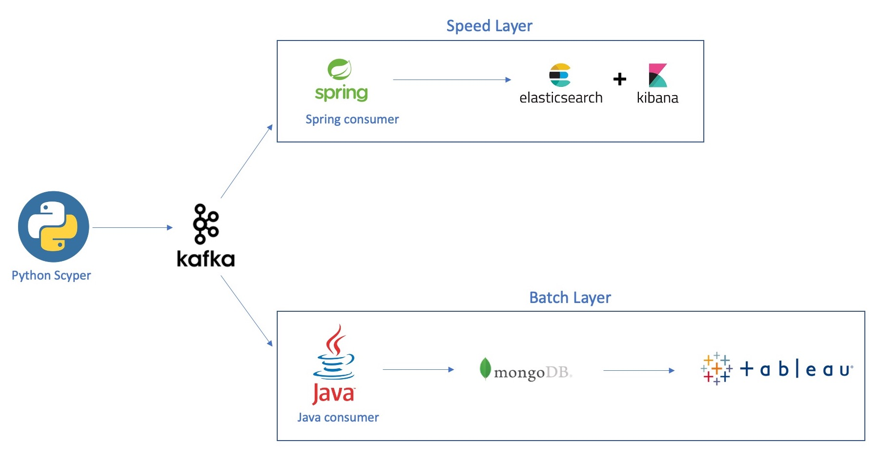
Architecture
Lambda Architecture:
Scryper
Apache Kafka
Speed Layer
Spring Consumer
Elasticsearch
Kibana
Batch Layer
Java Consumer
MongoDB
Tableau

Slide 5
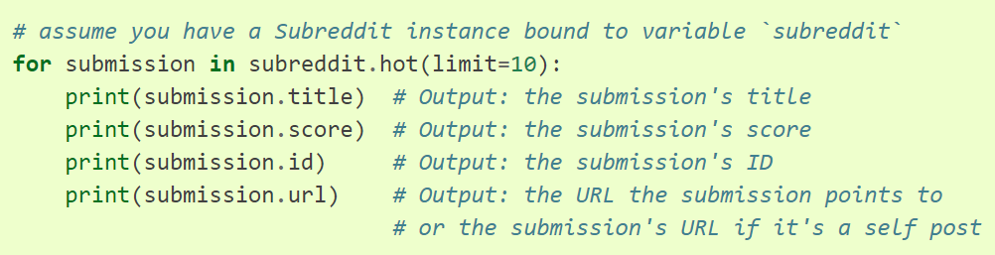
Scryper
Written in Python
Uses PRAW (Python Reddit API Wrapper)
Downloads data about:
Top 10 hottest threads
Their comments
And their respective authors
Multi-threaded

Slide 6
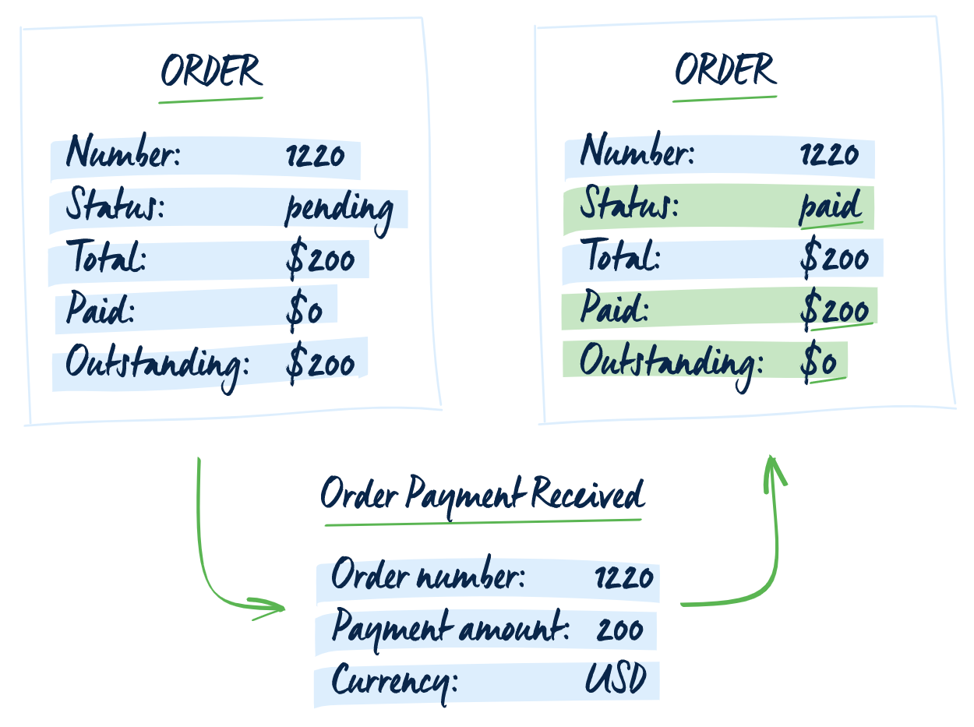
Apache kafka
Apache Kafka is a distributed data streaming platform
We used the event-sourcing approach
One topic per entity type:
Threads
Users
Subreddit-data
Comments also go in the Threads topic
Message ordering over logical partitioning (Kleppmann)

Slide 7



Speed layer
Speed consumer reads data from Kafka topics and stores in Elasticsearch index
Elasticsearch stores data in indexes (as JSON files)
Kibana searches and visualizes data stored in Elasticsearch indexes.
Dashboard for real-time monitoring

Slide 8
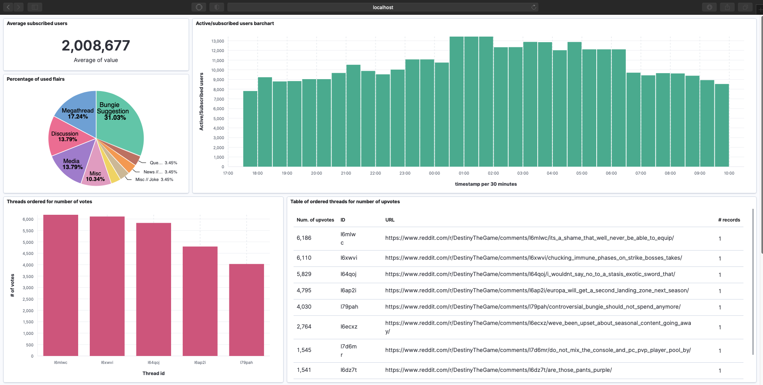
Kibana dahboard (1/2)
Lens has been used for creation of the different kinds of charts

Slide 9
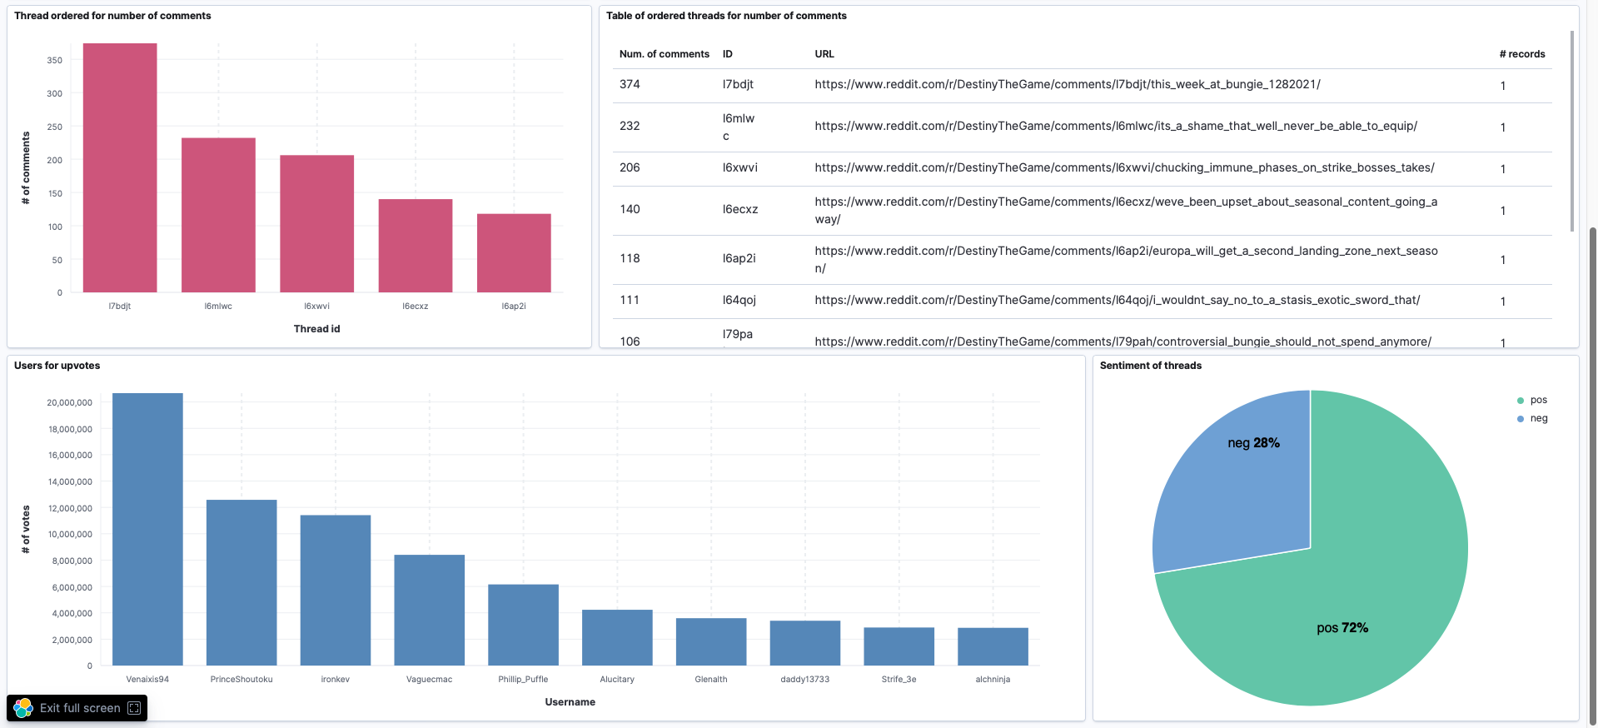
Kibana dashboard (2/2)

Slide 10

Batch layer
Batch consumer reads from Kafka topics and stores it in MongoDB
Why MongoDB?
Easy to use
Documents are in JSON format
Scalability via auto-sharding
Can connect to Tableau via MongoDB BI Connector

Slide 11
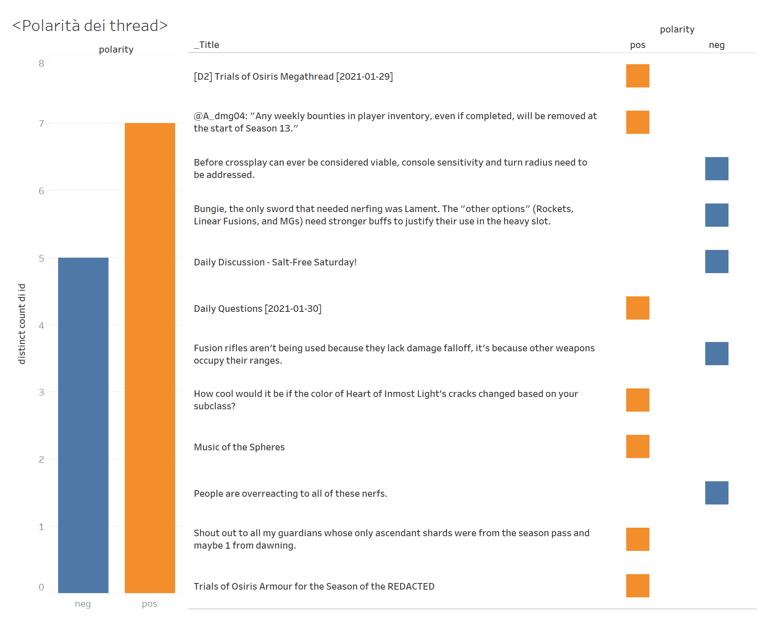
TABLEAU (1/2)
OLAP
Visualization types:
Worksheets
Dashboards
Stories

Slide 12
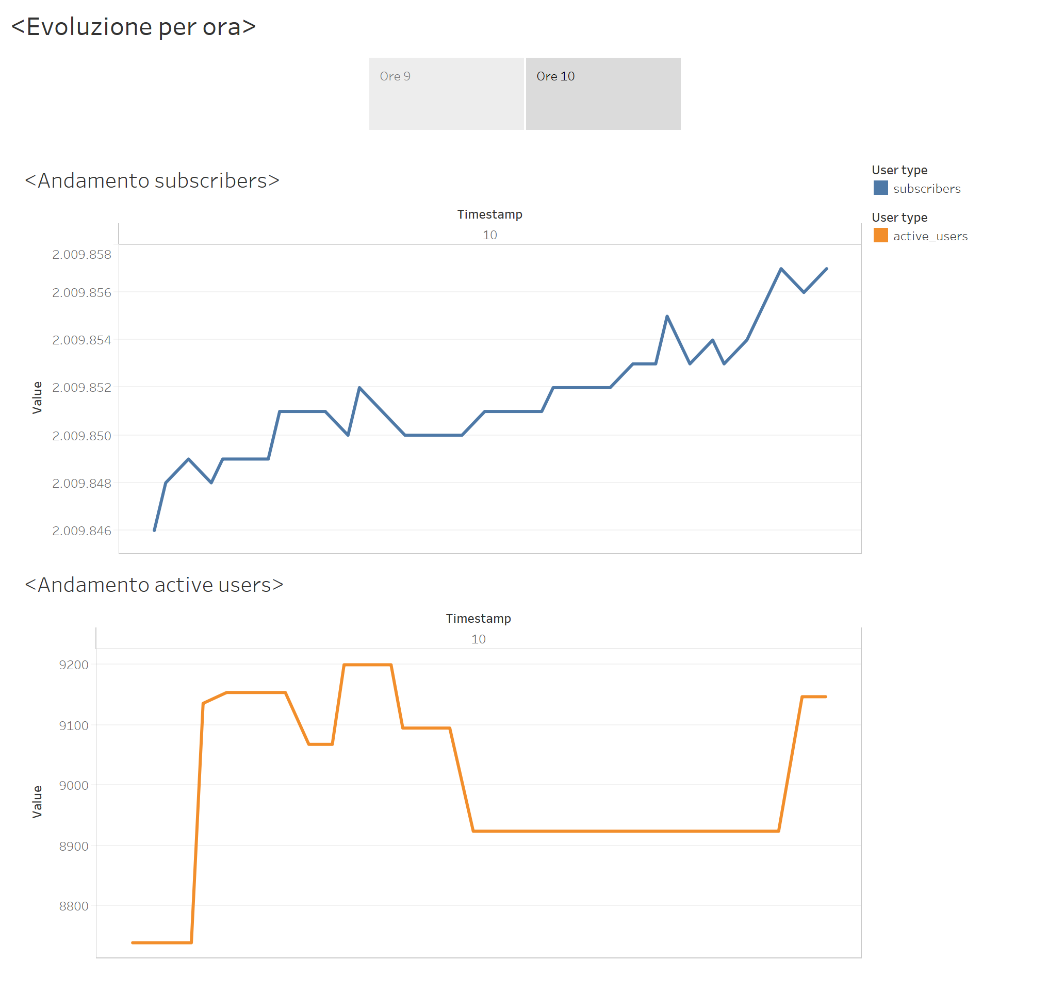
Tableau (2/2)

Slide 13

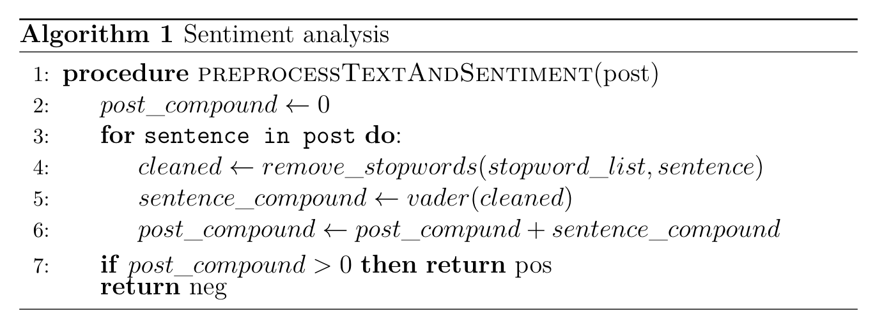
Sentiment analysis
Algorithm for simple text preprocessing and sentiment analysis (with VADER)
Why VADER?
Considers polarity score for slang, emoji etc.
Suitable for social network data

Slide 14
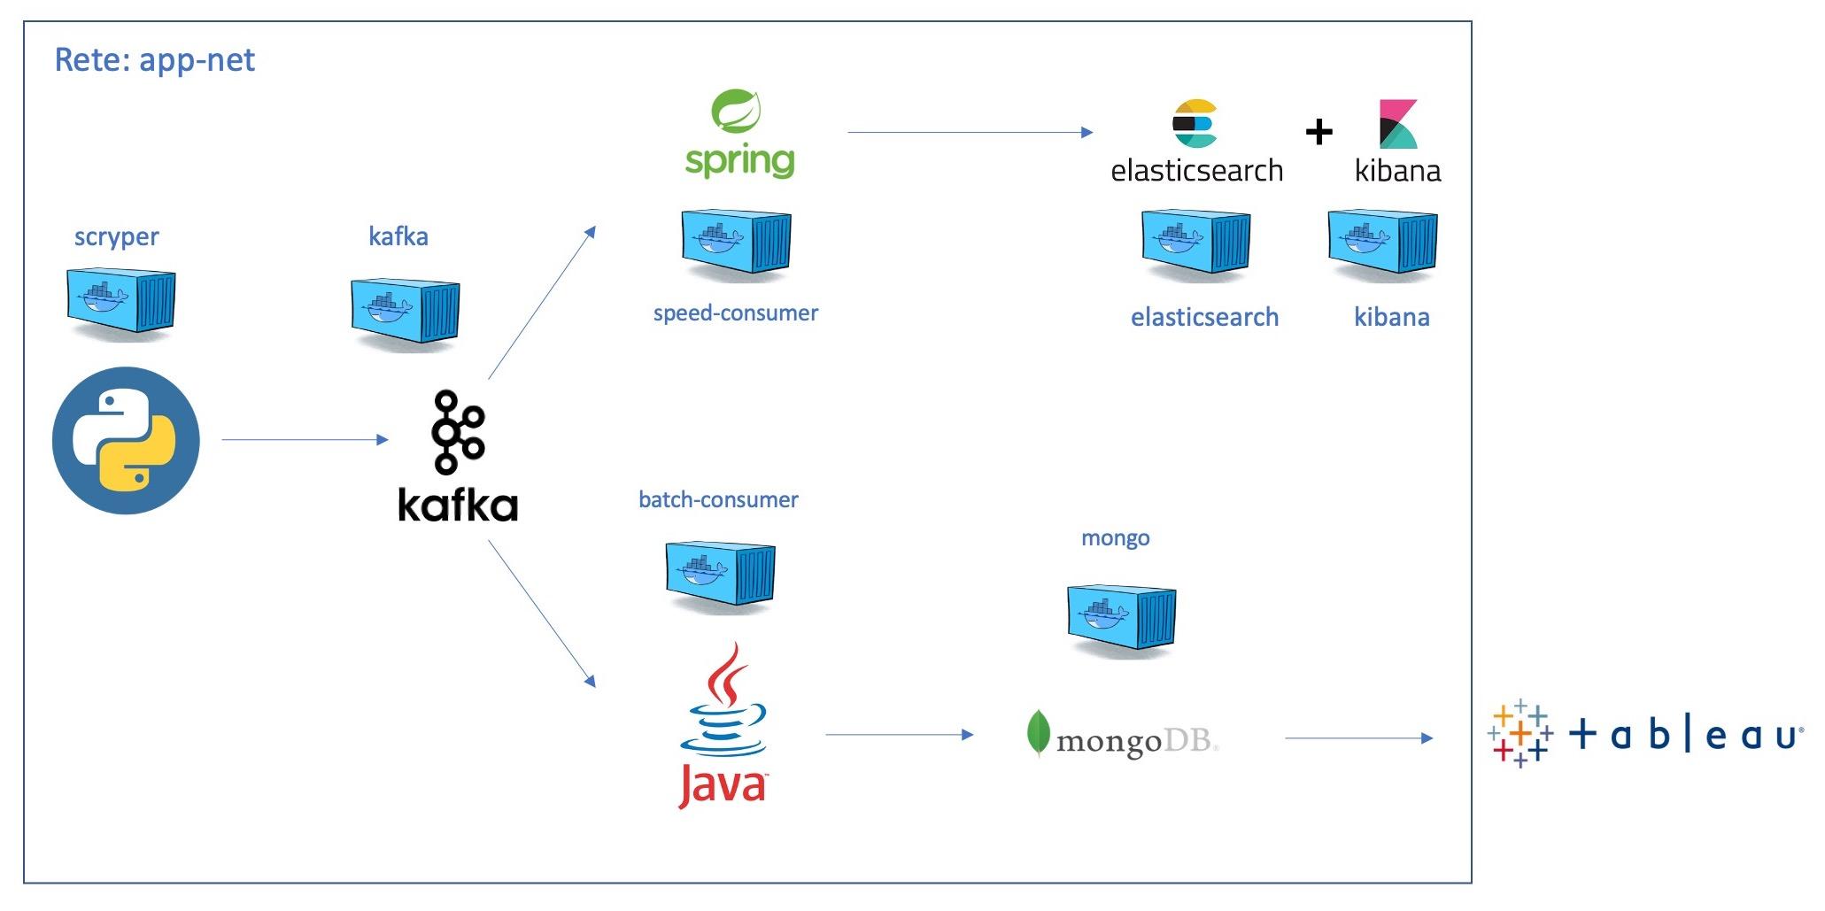
Deployment
Images downloaded from Docker Hub:
Apache Kafka
Elasticsearch
Kibana
MongoDB
Added Dockerfile for Consumers and Scryper
Docker Compose was used for application deployment on a single host
Same docker net

Slide 15
conclusion
Main challenges:
Architecture design (which patterns/DBs to use)
Learning how to use all the different tools
Dockerization
Future developments:
Adding the ability to monitor multiple subreddits
Training a ML model for offensive/spam comments detection in the batch layer data

